Slide 1
VTE Prophylaxis
Updates and Clarification to the Process

Slide 2
This NetLearning is meant to clarify common confusion regarding the VTE Prophylaxis Process. If you did not attend a Meaningful Use Class or take the original NetLearning, “Meaningful Use Mandatory NetLearning”, please view both to ensure that you understand the process completely!

Slide 3
Recent Revisions to the VTE Risk Assessment Tool
Changes in wording
New BMI Chart
Reference Added
Paper is now BLUE

Slide 4
Section One
Section Two
Section Three
Section Four

Slide 5
Risk Assessment: Section One
Wording changed so that this Risk Assessment must be completed UPON ADMISSION, NOT within 24 hours
BMI is important! Many of the Risk Factors are associated with a patient’s BMI!
The BMI Chart on the back of the Risk Assessment Tool has been changed so that it is more user friendly!
Please see the next slide

Slide 6
Revised BMI Chart

Slide 7
Risk Assessment: Section Two
Clarifications:
If a patient is on a THERAPEUTIC anticoagulation medication, you will still need to do the VTE Risk scoring, as Mechanical Prophylaxis could be indicated for the patient, based on score.
If Admission orders already contain some VTE Prophylaxis orders, the RN should:
Transfer those orders onto the VTE Prophylaxis Orders Form
Call the Physician when necessary to obtain any additional prophylaxis orders based on risk score requirements

Slide 8
Examples
Example #1:
Risk Score: 4
Admission Orders Contain: Lovenox
RN will need to call the MD to get an TORV for AT Pumps or PlexiPulse OR a TORV for a contraindication
Example #2:
Risk Score: 5
Admission Orders Contain: Lovenox and AT Pumps
RN will need to get a TORV for Ted Hose OR a TORV for a contraindication

Slide 9
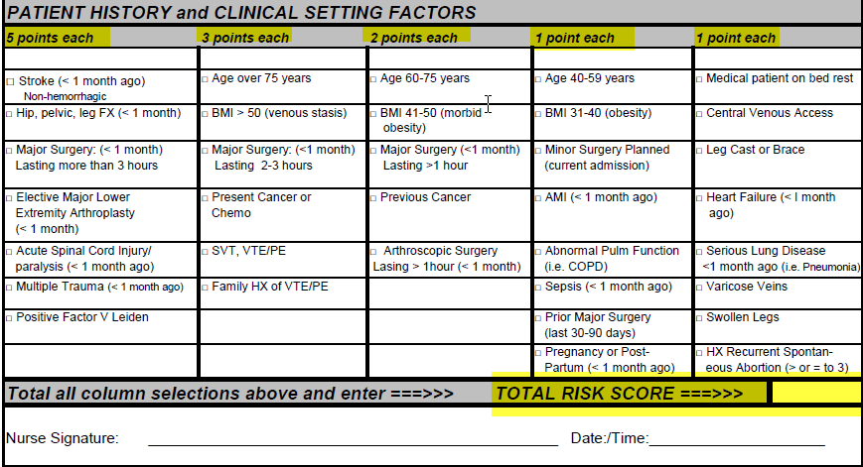
Risk Assessment: Section Three
Each risk factor is associated with a point value, based on the column it is in.
Once a patient reaches 5 points, you can stop scoring as that patient will be considered “Highest Risk”
This MUST be filled out carefully. If a patient is not scored correctly, we are putting them at risk by not ordering appropriate VTE Prophylaxis

Slide 10
Risk Assessment: Section Four
The Risk Score needs to be adjusted post surgery when:
Patients come in through Out Patient Surgery “to be admitted”
Patients are sent to surgery the day OF or the day AFTER hospital admission
The PACU or Critical Care RN (for patients who bypass PACU) must:
Document the Surgery Table Time
Adjust the Risk Score accordingly by looking in the Patient History and Clinical Setting Factors
Major Surgery lasting more than 3 hours = 5 points
Major Surgery lasting 2-3 hours = 3 points
Major Surgery lasting 1-2 hours = 2 points
Minor Surgery = 1 point

Slide 11
VTE Prophylaxis Orders Revisions:
Lymphedema has been removed for the contraindications for Mechanical Prophylaxis
Ted Hose has been removed as an option for Moderate Risk patients
Ted Hose have been made OPTIONAL for patients in the High Risk Category
These patients must have either AT Pumps or Plexi-Pulse AND chemical prophylaxis
Lab orders revised to include Comprehensive Metabolic Panel, instead of Basic Metabolic Panel to pick up those patients with liver disease or bleeding disorders
SCIP VTE Prophylaxis Guidelines included to assist surgeons with ordering VTE Prophylaxis

Slide 12
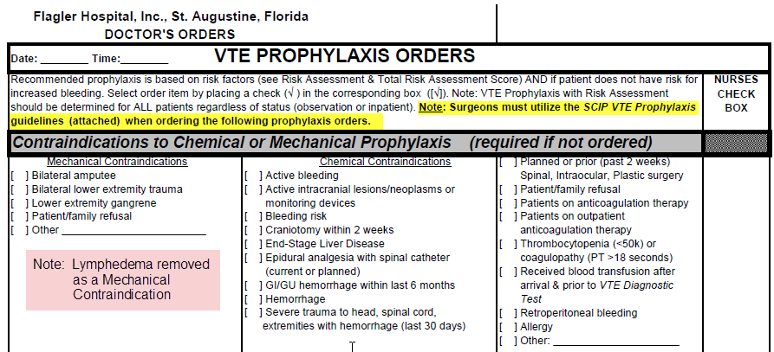
VTE Prophylaxis Orders: Contraindications

Slide 13
VTE Prophylaxis: Low & Moderate Risk
Patients who are a Moderate Risk, need one form of VTE Prophylaxis ordered – either chemical OR mechanical

Slide 14
VTE Prophylaxis Orders: High Risk
Ted Hose have been made OPTIONAL for patients in the High Risk Category
These patients must have either AT Pumps or Plexi-Pulse AND chemical prophylaxis

Slide 15
VTE Prophylaxis Orders: Highest Risk
Highest Risk patient must have 3 Forms of Mechanical Prophylaxis:
Ted Hose
AT Pumps or Plexipulse
Chemical

Slide 16
VTE Prophylaxis Orders: Labs

Slide 17
Work Flow for Patients Admitted Through ECC:
ECC RN will:
Complete Risk Assessment
Obtain VTE Prophylaxis Orders
Admission RN will:
Document Risk Score and Orders in Admission Assessment
Apply Ted Hose if applicable
Administer chemical prophylaxis if appropriate
Floor/ICU RN will:
Document any mechanical prophylaxis that he/she applies in the VTE Admission Assessment & Intervention screen
Document Q4 hours on the VTE mechanical prophylaxis monitoring intervention
Note: If no mechanical prophylaxis was ordered, change the status of the VTE Mechanical Prophylaxis Monitoring Intervention and the VTE Admission Assessment & Intervention to Complete

Slide 18
Work Flow for Patients Admitted Through OPS:
OPS RN will:
Complete Risk Assessment
PACU RN (or ICU RN if patient bypasses PACU) will:
Adjust Risk Score based on surgery table time
Apply Mechanical Prophylaxis and document date and time applied
Floor/ICU RN will:
Document Risk Score and VTE Prophylaxis Orders in the Nursing Admission Assessment
Document any mechanical prophylaxis that he/she applies in the VTE Admission Assessment & Intervention screen
Document Q4 hours on the VTE mechanical prophylaxis monitoring intervention
Note: If mechanical prophylaxis was applied in PACU, the Floor/ICU RN should change the status of the VTE Admission Assessment & Intervention to Complete to remove it from the list of process interventions!
Note: If no mechanical prophylaxis was ordered, change the status of the VTE Mechanical Prophylaxis Monitoring Intervention to Complete

Slide 19
Work Flow for Direct Admits:
Admission RN will:
Complete Risk Assessment
Obtain VTE Prophylaxis Orders
Document Risk Score and Orders in Admission Assessment
Apply Ted Hose if applicable
Administer chemical prophylaxis if appropriate
Floor/ICU RN will:
Document any mechanical prophylaxis that he/she applies in the VTE Admission Assessment & Intervention screen
Document Q4 hours on the VTE mechanical prophylaxis monitoring intervention
Note: If no mechanical prophylaxis was ordered, change the status of the VTE Mechanical Prophylaxis Monitoring Intervention and the VTE Admission Assessment & Intervention to Complete

Slide 20
Clarifications to the Workflow
BMI must be calculated for all patients, as many factors are attributed to a patient’s BMI
A patients ACTUAL weight should be utilized, not a STATED weight
Risk Assessment must be completed before Admission Orders are obtained
VTE Prophylaxis Orders must be obtained by the ECC RN when Admission Orders are obtained
It is essential that the Risk Assessment is filled out correctly so that appropriate VTE Prophylaxis is ordered for the patient
This process does apply to CVU patients who stay overnight after a stent placement

Slide 21
Clarifications to the Workflow:
For patients that come in through the ECC, it is imperative that the ECC RN and the Admission RN communicate to ensure that patients are not double-dosed on chemical prophylaxis
A stamp has been created to indicated when an initial dose has been given
The stamp can be used by either the ECC RN or the Admission RN
The stamp states:
1st dose Lovenoz/Heparin
Administered per VTE Protocol
By ____________ @ _______
On _________, 20____

Slide 22
Clarification to the Paper Documentation Process
Paper Documentation
VTE Risk Assessment Tool
Should be completed by ECC RN if admitted through ECC, by the OPS RN is admitted through OPS as a “To Be Admitted”, or the Floor RN for direct admits
VTE Prophylaxis Orders
Should be obtained by the RN who does the VTE Risk Assessment Tool
RN needs to ensure that orders match the Risk Score
If the appropriate prophylaxis is not ordered, there must be a documented contraindication
If a MD refuses to order appropriate VTE Prophylaxis or to document a contraindication, please notify your director

Slide 23
Clarification to the MediTech Documentation
The following must be charted in the Nursing Admission Assessment
Risk Score
Whether Mechanical and/or Chemical were ordered
Date and Time Ted Hose applied by Admission RN (if applicable)
Process Interventions (see following slides for explanations):
VTE Admission Assessment and Intervention
VTE Reassessment and Intervention
VTE Mechanical Prophylaxis Monitoring

Slide 24
VTE Admission Assessment & Intervention
What is the Floor/ICU RNs responsibility?
Document any mechanical prophylaxis that YOU APPLY on the patient
You will need to document date and time applied
This only needs to be documented 1X, not Q shift
Change the Status of the Intervention to COMPLETE if:
No mechanical prophylaxis was ordered
OR if it was already applied by the Admission RN or by the PACU RN
To change a status to COMPLETE:
Highlight the intervention
Change Status (CS)
In Status box, change “A” to “C”
File the Intervention (It will be removed from the list of Process Interventions once you log out and log back in)

Slide 25
VTE Mechanical Prophylaxis Monitoring
What is the Floor/ICU RNs responsibility?
Document Q4 hours if any Mechanical Prophylaxis is ordered for the patient
You will document:
If Mechanical Prophylaxis is currently in use
Document any comments as necessary
What if no Mechanical Prophylaxis was ordered?
Change the Status of the Intervention to COMPLETE
Highlight the intervention
Change Status (CS)
In Status box, change “A” to “C”
File the Intervention (It will be removed from the list of Process Interventions once you log out and log back in)

Slide 26
VTE ReAssessment & Intervention
When should the RN document on this intervention?
The ICU (MICU, SICU, OHR) RN will document on this intervention AFTER a transfer from the floor up to their unit
The floor or ICU RN will document on this intervention when a patient returns from surgery (only if the surgery was the day OF or the day AFTER admission)

Slide 27
Clarification to Transfer of Care Process:
The Receiving Unit is now responsible for obtaining the Transfer of Care Orders AND the Transfer Medication Reconciliation for every transfer
The VTE Reassessment only needs to be done when a patient transfers up a level of care to MICU, SICU, or OHR

